Slide 1
A Sleep Tracking App for a Better Night's Rest
Dharshini.S (715522243016)
Laxmi Priyya.KS (715522243029)
Shevarthna.M (715522243046)
Karthikeyan.S (715522243306)
Leela.GM (715522243303)

Slide 2
DESCRIPTION
A Sleep Tracking App is a mobile application designed to help users monitor and improve their sleep patterns. It serves as a tool for tracking sleep duration, assessing sleep quality, and providing insights to optimize rest and overall well-being.
Sleep Timer:
One of the core features of the Sleep Tracking App is the sleep timer. Users activate the timer when they’re about to fall asleep, and it continues running in the background while the user sleeps. The timer stops automatically when the user wakes up, capturing the total sleep duration.
Sleep Quality Rating:
After waking up, users can rate their sleep quality on a scale (e.g., 1-5), reflecting how rested and refreshed they feel. This subjective input helps the app track the user’s sleep experience over time, offering valuable feedback on sleep trends.
Sleep Analysis:
The app provides an analysis of the previous night’s sleep based on both the sleep duration and the quality rating provided by the user. It displays a summary of the night’s sleep, including total sleep time and any patterns that may emerge in sleep quality.

Slide 3
DESCRIPTION
Trends and Insights:
Over time, the app gathers data on the user’s sleep habits, presenting it through graphs and charts. These insights help users identify factors that may be impacting their sleep, such as lifestyle choices or irregular sleep patterns.
User Interface:
The app is designed using Android Jetpack Compose, offering an intuitive and easy-to-navigate interface. The focus is on simplicity and clarity, with users able to easily start/stop the sleep timer, rate their sleep, and view their sleep analysis in just a few taps.
Goal of the App:
The primary goal of the Sleep Tracking App is to empower users to take charge of their sleep health. By providing a straightforward way to track and analyze sleep patterns, the app encourages better sleep hygiene and helps users improve their overall health and productivity.

Slide 4
SleepTrackerFragment.kt
package com.example.android.trackmysleepquality.sleeptracker
import android.os.Bundle
import android.view.LayoutInflater
import android.view.View
import android.view.ViewGroup
import androidx.databinding.DataBindingUtil
import androidx.fragment.app.Fragment
import androidx.lifecycle.Observer
import androidx.lifecycle.ViewModelProvider
import androidx.navigation.fragment.findNavController
import com.example.android.trackmysleepquality.R
import com.example.android.trackmysleepquality.database.SleepDatabase
import com.example.android.trackmysleepquality.databinding.FragmentSleepTrackerBinding
import com.google.android.material.snackbar.Snackbar
class SleepTrackerFragment : Fragment() {
override fun onCreateView(inflater: LayoutInflater, container: ViewGroup?,
savedInstanceState: Bundle?): View {
val binding: FragmentSleepTrackerBinding = DataBindingUtil.inflate(
inflater, R.layout.fragment_sleep_tracker, container, false)
val application = requireNotNull(this.activity).application
val dataSource = SleepDatabase.getInstance(application).sleepDatabaseDao

Slide 5
val viewModelFactory = SleepTrackerViewModelFactory(dataSource, application)
val sleepTrackerViewModel =
ViewModelProvider(
this, viewModelFactory).get(SleepTrackerViewModel::class.java)
binding.sleepTrackerViewModel = sleepTrackerViewMode
binding.lifecycleOwner = this
sleepTrackerViewModel.showSnackBarEvent.observe(viewLifecycleOwner, Observer {
if (it == true) {
Snackbar.make(
binding.root,
getString(R.string.cleared_message),
Snackbar.LENGTH_SHORT // How long to display the message.
).show()
sleepTrackerViewModel.doneShowingSnackbar()
} })
sleepTrackerViewModel.navigateToSleepQuality.observe(viewLifecycleOwner, Observer { night ->
night?.let {
this.findNavController().navigate(
SleepTrackerFragmentDirections
.actionSleepTrackerFragmentToSleepQualityFragment(night.nightId))
sleepTrackerViewModel.doneNavigating()
} })
return binding.root }}

Slide 6
SleepTrackerViewModel.kt
package com.example.android.trackmysleepquality.sleeptracker
import android.app.Application
import androidx.lifecycle.viewModelScope
import androidx.lifecycle.AndroidViewModel
import androidx.lifecycle.LiveData
import androidx.lifecycle.MutableLiveData
import androidx.lifecycle.map
import com.example.android.trackmysleepquality.database.SleepDatabaseDao
import com.example.android.trackmysleepquality.database.SleepNight
import com.example.android.trackmysleepquality.formatNights
import kotlinx.coroutines.*
class SleepTrackerViewModel(
val database: SleepDatabaseDao,
application: Application) : AndroidViewModel(application) {
private var tonight = MutableLiveData<SleepNight?>()
private val nights = database.getAllNights()
val nightsString = nights.map { nights ->
formatNights(nights, application.resources)}
val startButtonVisible = tonight.map {
null == it
}

Slide 7
val stopButtonVisible = tonight.map {
null != it}
val clearButtonVisible = nights.map {
it.isNotEmpty() }
private var _showSnackbarEvent = MutableLiveData<Boolean>()
val showSnackBarEvent: LiveData<Boolean>
get() = _showSnackbarEvent
private val _navigateToSleepQuality = MutableLiveData<SleepNight?>()
fun doneShowingSnackbar() {
_showSnackbarEvent.value = false}
val navigateToSleepQuality: LiveData<SleepNight?>
get() = _navigateToSleepQuality
fun doneNavigating() {
_navigateToSleepQuality.value = null }
init {
initializeTonight() }
private fun initializeTonight() {
viewModelScope.launch {
tonight.value = getTonightFromDatabase() }}
private suspend fun getTonightFromDatabase(): SleepNight? {
var night = database.getTonight()
if (night?.endTimeMilli != night?.startTimeMilli) {
night = null }
return night }

Slide 8
private suspend fun clear() {
database.clear()}
private suspend fun update(night: SleepNight) {
database.update(night)}
private suspend fun insert(night: SleepNight) {
database.insert(night)}
fun onStartTracking() {
viewModelScope.launch {
val newNight = SleepNight()
insert(newNight)
tonight.value = getTonightFromDatabase() } }
fun onClear() {
viewModelScope.launch {
clear()
tonight.value = null}
_showSnackbarEvent.value = true
}}

Slide 9
MainActivity.kt
package com.example.android.trackmysleepquality
import android.os.Bundle
import androidx.appcompat.app.AppCompatActivity
class MainActivity : AppCompatActivity() {
override fun onCreate(savedInstanceState: Bundle?) {
super.onCreate(savedInstanceState)
setContentView(R.layout.activity_main)
}
}

Slide 10
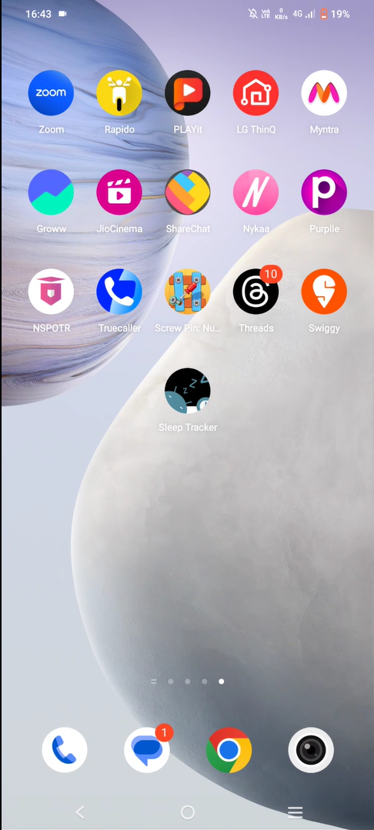
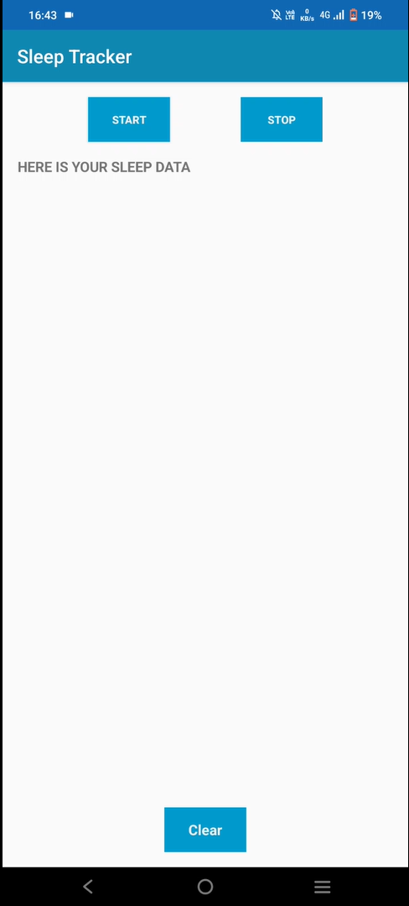
OUTPUT:

Slide 11
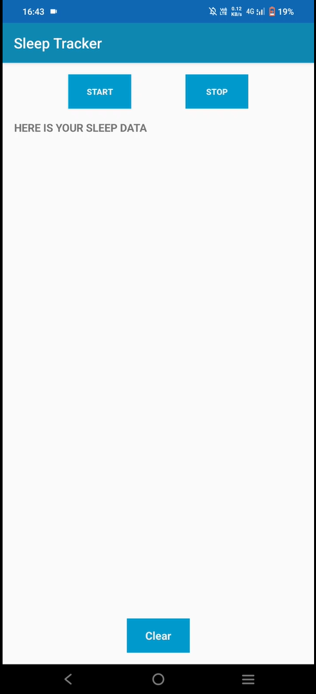
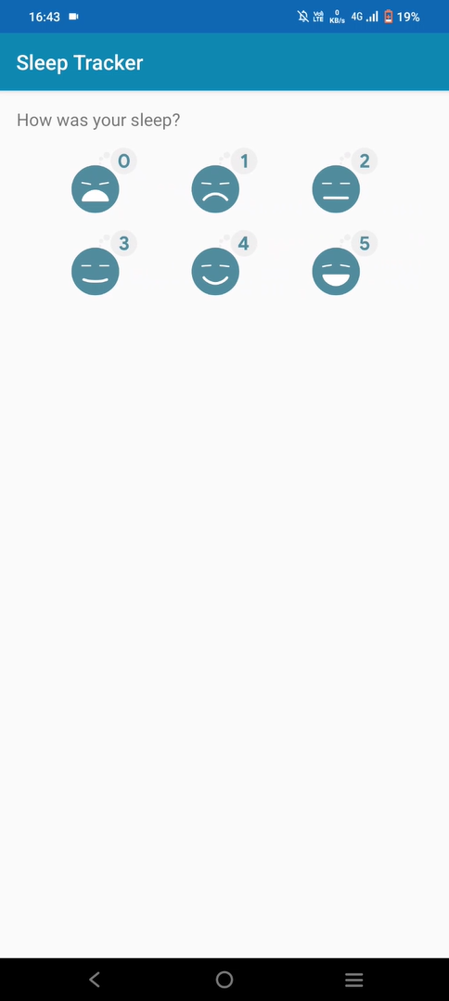

Slide 12
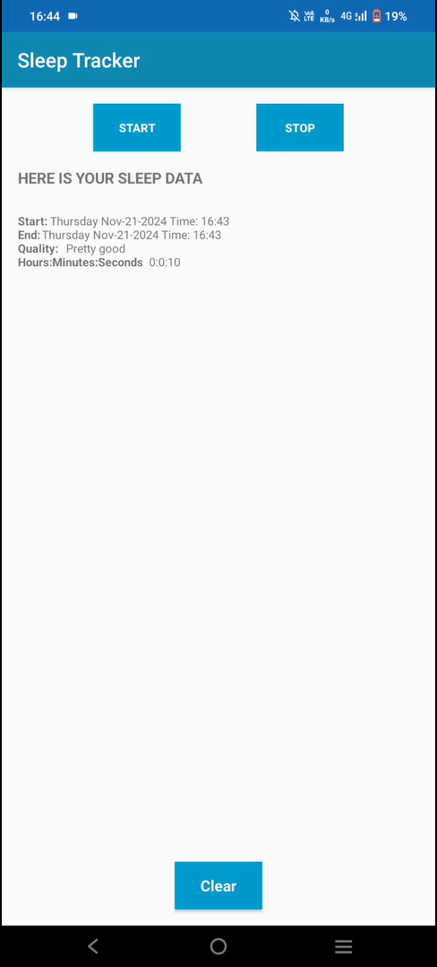
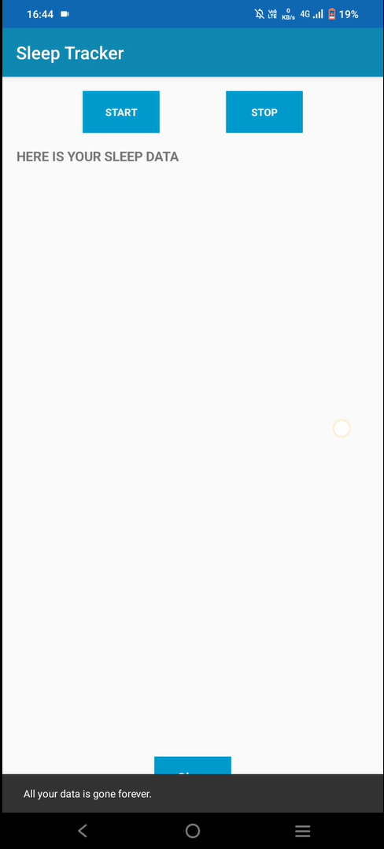

Slide 13
Links
GIT Hub: https://github.com/shevarthna/sleep-tracker.git
Demo video: https://inshotapp.page.link/InShotEditor

